Slide 1
Networked Improvement Communities
Developing a Theory of Action and Logic Model
[Month, Year]

Slide 2
Establish Teams and Identify the Problem
Developing a well-specified problem statement
Developing a Theory of Action and Logic Model
Notes:
This presentation is for state and local leaders who are interested in developing a theory of action and logic model to address a problem of practice. The presentation introduces theories of action and logic models, discusses their purpose and importance within the continuous improvement cycle, and provides examples to support their development.
This presentation supports the fifth of eight steps in the networked improvement community approach to improvement. You can find a full set of resources to support networked improvement communities at https://region5compcenter.org/nic. The work is supported through the U.S. Department of Education’s (ED’s) regional comprehensive center program.

Slide 3
Meeting Objectives
Identify essential components of a theory of action and logic model
Understand how to develop a theory of action and logic model
Using concepts from today’s session, develop concrete goals and create an initial theory of action and logic model
Notes:
The Region 5 Comprehensive Center developed materials to facilitate networked improvement communities (NICs) in developing a theory of action and logic model. Resources include this PowerPoint (PPT) presentation, as well as a draft meeting agenda and meeting facilitator guide. The meeting objectives are described on this slide.

Slide 4
Revisiting the NIC Model of Improvement
Increased Capacity to Address Problems of Practice
Root Causes
Theory of Action
Improved Practice
Problem of Practice
Logic Model
Measurement Infrastructure
Improvement Science (Plan, Do, Study, Act)
Notes:
A NIC starts with a well-defined problem of practice. From there we identify root causes, identify clear goals, and create a theory of action that operationalizes a process through which these goals can theoretically be achieved. The logic model translates the theory of action into a sequential set of resources, activities, outputs, and outcomes that can be measured and evaluated. This presentation will unpack theories of action and logic models to describe why they are important and how they can be developed and used to support improvement.

Slide 5
Why Develop a Theory of Action and Logic Model?
If you don't know where you're going, you'll end up someplace else.
― Yogi Berra
Notes:
This quote from Yogi Berra captures the essence of why theories of action and logic models are such important resources in the continuous improvement process.
Stakeholders may have very different goals or ideas about the types of solutions needed.
Collectively, state or district stakeholders can become less and less clear about the goals they are trying to accomplish, or the path they intend to take to reach them.
Interactions with stakeholders who don’t agree can create confusion and prevent real progress from taking place.
Numerous daily distractions and rabbit holes can also impede progress.
The consequences of trying to get somewhere without having a clear destination—or set of goals—include:
Lack of coordination, increasing siloes among individuals and departments;
Both leadership and staff retreating to the status quo;
Abandoning school improvement plans; and
Daily distractions that result in no meaningful outcomes.
A theory of action can prevent these pitfalls. Essentially, a theory of action is a road map that describes key goals and outcomes and provides directions (i.e., a defined program or set of practices/strategies) for how to achieve those outcomes. Logic models provide the structure needed to measure and evaluate the proposed theory of action.
Let’s dive into a theory of action a little bit more.

Slide 6
Theory of Action Defined
Theories of action are simply agreed-upon explanations of how a group of stakeholders will achieve a common goal
The starting point of a theory of action is a clear understanding of the goal
A theory of action is informed by
A well-specified problem statement
A comprehensive root cause analysis
Increased Capacity to Address Problems of Practice
Problem of Practice
Root Causes
Theory of Action
Improved Practice
Logic Model
Measurement Infrastructure
Improvement Science (Plan, Do, Study, Act)
Notes:
For resources and information on how to develop problem statements and identify root causes, go to https://region5compcenter.org/nic
See also Anderson, A.A. (2006). The community builder’s approach to theory of change: A practical guide to theory development. Available at: https://www.theoryofchange.org/pdf/TOC_fac_guide.pdf

Slide 7
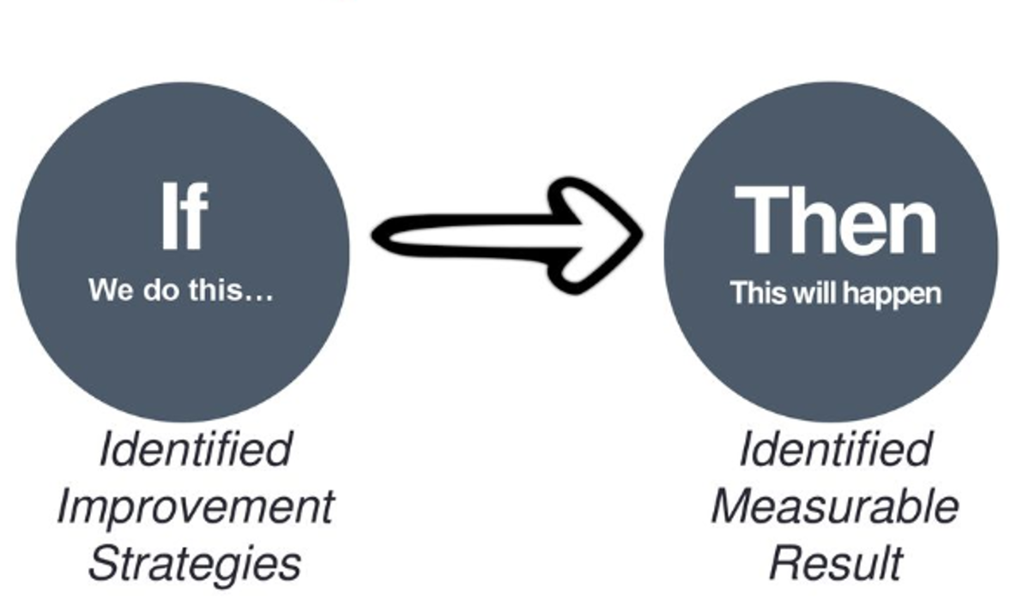
Developing a Simple Theory of Action
Notes:
A theory of action starts as a set of if-then statements that are designed to address a specific problem of practice. The “if” statements represent research-based tools and practices. The “then” statements represent measurable results.

Slide 8
A Simple Theory of Action
If we marshal resources to spray water on the fire, then the fire will extinguish.
Notes:
Let’s look at this from a very simplified perspective. We have a general sense of our if-then relationship. Note that a theory of action tends to cast a wide view and doesn’t necessarily clarify the “how” of meeting the goal from a practical or concrete point of view.

Slide 9
Features of a Well-Specified Theory of Action
Developing a theory of action is a multi-step and iterative process, but follows an increasingly detailed set of steps with the following features:
Relationships
Are outcomes clearly described?
Program Activities
Are activities and/or strategies specific?
Success Conditions
What resources are needed to promote these conditions?
Assumptions
What are the underlying assumptions?
Are they clear and measurable?
Have we identified relationships among them?
What information helps the theory make sense?
What are pre-conditions for success?
Notes:
Features of a well-specified theory of action include relationships, program inputs/activities, success conditions, and assumptions. Questions are listed here to support the NIC as they consider how to address a problem of practice and systematically achieve long-term goals and outcomes.
For more information, see Anderson, A.A. (2006). The community builder’s approach to theory of change: A practical guide to theory development. Available at: https://www.theoryofchange.org/pdf/TOC_fac_guide.pdf

Slide 10
Transitioning from Theory to Practice…
The theory of action casts a wide view of the program by specifying relationships between broader improvement strategies and their expected outputs and outcomes.
The logic model makes explicit connections across resources, activities, outputs, and outcomes to (1) articulate how a theory of change is designed to work in practice, and (2) evaluate its effectiveness.
The implementation plan builds from the logic model by specifying the nuts and bolts of how components of the logic model (i.e., the program) will be delivered. The implementation plan typically includes assignments, detailed procedures, timelines, and key milestones.
Theory of Action
Logic Model
Implementation
Plan
Notes:
People use a lot of different terms when referencing theories of action. You may have heard terms like theories of change, theories of improvement, logic models, and driver diagrams. These terms are sometimes used interchangeably because their definitions overlap and the differences in some of these terms are really a matter of nuance or may even depend on the field in which you were trained.
For that reason, we distinguish here between theory of action, logic models, and implementation plans. From one point of view, you can think of these terms as running along a continuum from less to more detailed plans. And that may explain, at least in part, why the difference between a theory of action and logic model is not always crystal clear.
The theory of action casts a wide view of the program.
The logic model operationalizes the theory by describing what happens first, second, third, and so on, in order to achieve outcomes. It specifies the resources, activities, outputs, and outcomes that comprise a particular hypothesis. It also creates a causal chain to link activities and their requisite outputs which, in turn, should influence a specific set of outcomes. Logic models are important resources for evaluators because the added specificity allows the evaluator to connect specific tools to examine the implementation process and investigate for whom, how, and under what conditions a program works as designed.
The implementation plan builds on the logic model by getting even more specific. It lays out the plans that each department, and people within a department, must do to implement the logic model. It can be used to assign tasks, inform timelines, and assign ownership to specific aspects of the implementation process.

Slide 11
The Logic Model…
Operationalizes the theory so that it is measurable
Specifies resources, inputs, activities, outputs, and outcomes
Informs a robust measurement infrastructure
Generally (and foundationally) clarifies connections and assumptions in order to support high-quality implementation
Notes:
A key difference between logic models and theories of action is that logic models utilize a specific and standardized format, specifying resources, inputs or activities, outputs, and outcomes. Additionally, logic models organize a theory of action into a sequential model that supports measurement and evaluation.
For more information, see the following resources:
W.K Kellogg Foundation. (2004). Logic model development guide. Battle Creek, MI: Author. This guide can be downloaded at https://www.aacu.org/sites/default/files/LogicModel.pdf
Shakman, K., & Rodriguez, S.M. (2015). Logic models for program design, implementation, and evaluation: Workshop toolkit (REL 2015–057). Washington, DC: U.S. Department of Education, Institute of Education Sciences, National Center for Education Evaluation and Regional Assistance, Regional Educational Laboratory Northeast & Islands. Retrieved from http://ies.ed.gov/ncee/edlabs.

Slide 12
Defining the Elements of a Logic Model
Term | Definition
Resources | Resources include the human, financial, organizational, and community resources a program has available to direct toward doing the work. Sometimes this component is referred to as “Inputs.” Multiple preceding inputs can also be identified.
Activities | Activities are what the program does with the resources. Activities are the processes, tools, events, technology, and actions that are an intentional part of the program implementation. These interventions are used to bring about the intended program changes or results.
Outputs | Outputs are the direct products of program activities and may include types, levels and targets of services to be delivered by the program.
Outcomes | Outcomes are the specific changes in program participants’ behavior, knowledge, skills, status, and level of functioning. Short-term outcomes should be attainable within 1 to 3 years, while longer-term outcomes should be achievable within a 4-to-6-year timeframe. The logical progression from short-term to long-term outcomes should be reflected in impact occurring within about 7 to 10 years.
Long-Term Outcomes | Long-Term Outcomes are the fundamental intended or unintended change occurring in organizations, communities, or systems as a result of program activities within 7 to 10 years.
Notes:
Definitions of logic model elements were adapted based on W.K Kellogg Foundation. (2004). Logic model development guide. Battle Creek, MI: Author. This guide can be downloaded at https://www.aacu.org/sites/default/files/LogicModel.pdf

Slide 13
Revisiting the Simple Theory of Action
If we marshal resources to spray water on the fire, then the fire will extinguish.
Notes:
Let’s look at a simple example. The theory of action provides a general sense of our if-then relationship. But a theory of action doesn’t help you understand the actual “how” of meeting our goal. Let’s take a look at how we move from a theory of action to a logic model, which helps us better understand the connections between components of our theory of action.

Slide 14
Translating the Theory to a Simple Logic Model
GOAL: EXTINGUISH THE FIRE
Inputs | Outputs | (Short-Term) Outcomes
Ladder Hose with water Firefighters | Firefighters climb the ladder Firefighters spray water on the fire Firefighters bring the people down the ladder | The fire stops The people are saved from the fire
Notes:
Here you can see that all things are pointing to one goal. We have inputs, outputs, and outcomes. Inputs are those things that are necessary to fight the fire. The outputs are measurable results of the act of fighting the fire. The short-term outcomes are evidence of our activity of fighting the fire. If we have the inputs in place, and we see evidence of the outputs, we can monitor whether we meet our short-term outcome. If we meet our short-term outcomes, then we have extinguished the fire.
In education, our problems may seem less life or death, but are often much more complicated, involving many more stakeholder groups, many more perspectives, and strategies that require far more investment and effort.
Let’s take a look at an example that’s a little closer to home, educationally speaking.

Slide 15
Let’s Look at an Example from a State Department of Education
IF we…
Set high standards
Evaluate based on those standards
Regularly collect evaluation information
Provide targeted support based on that data
THEN…
Educators will become more effective
Students will have more equitable access to great educators
Student outcomes will improve
Notes:
This brings us to an educationally relevant theory of action. This example was pulled from one state department’s consolidated plan. We will walk through how to expand on this theory of action and show how it maps to the desired outcomes through actions made evident in the creation of a logic model. But first, we are going to organize this as a theory of action with hypothesized links and assumptions.

Slide 16
From Theory of Action to Logic Model
Learning Theory
Improved
Student Achievement
Reduced Achievement Gaps
Improved Systemic Goals (Socio-Emotional,
Civic, Cultural)
Standards and Learning Models
Curriculum-Instruction-Assessment Integration
Resources
Training
Guidance
Comprehensive Statewide System of Assessments
State Data Reports
Accountability for School Improvement
Deeper Learning
Assessment for Learning
State Longitudinal Data System
Notes:
This is a more detailed theory of action, which illustrates how a state can support school improvement through a mapping system. In order to translate this into a logic model, we need to be more explicit with naming our resources, inputs, outputs, and outcomes. Our next view brings up the more direct labels.

Slide 17
From Theory of Action to Logic Model (continued)
RESOURCES AND INPUTS
OUTPUTS
SHORT-TERM OUTCOMES
MID-TERM OUTCOMES
LONG-TERM OUTCOMES
Learning Theory
Improved
Student Achievement
Reduced Achievement Gaps
Improved Systemic Goals (Socio-Emotional,
Civic, Cultural)
Standards and Learning Models
Curriculum-Instruction-Assessment Integration
Resources
Training
Guidance
Comprehensive Statewide System of Assessments
State Data Reports
Accountability for School Improvement
Deeper Learning
Assessment for Learning
State Longitudinal Data System
Notes:
Here you can see how we’ve applied the labeling of resources and inputs, outputs, and outcomes to our theory of action. We are now getting to the point of developing a logic model.
We are not yet at the logic model though, since many of these elements are still not specific enough to be systematically observed and measured.

Slide 18
How Do We Get to the Outcomes?
Create a Logic Model
The logic model operationalizes the theory of action so that it becomes measurable!
Notes:
However, the previous slide organizes the theory into a sequential process that facilitates the development of a logic model. The logic model should operationalize the high-level theory into more concrete and measurable resources, activities, outputs, and outcomes that are clearly defined and can be observed and measured.

Slide 19
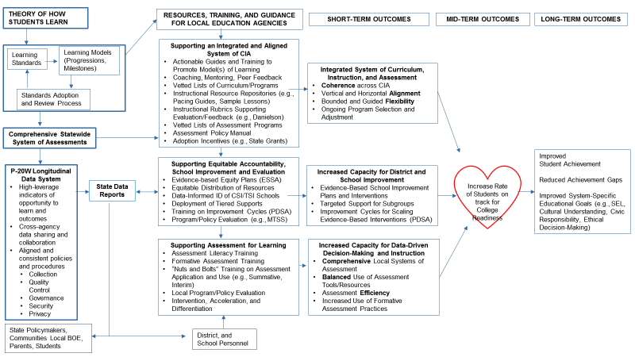
Theory of Action Becomes a Detailed Logic Model
RESOURCES AND INPUTS
OUTPUTS
SHORT-TERM OUTCOMES
MID-TERM OUTCOMES
LONG-TERM OUTCOMES
Notes:
This represents a more detailed version of the former theory of action. Although I won’t go through each step in this, please note that each of these boxes can be supported by multiple logic models. There is a lot going on here! But it is indicative of the interconnected nature of programs and how there are many paths to get to the same outcome, often with synergistic effects.
EXTRA NOTES TO EXPLAIN THIS SAMPLE LOGIC MODEL
To support integration of curriculum, instruction, and assessment (CIA), states can create …
To build capacity for accountability and school improvement, states can provide communication and training on Every Student Succeeds Act (ESSA) requirements, state identification procedures, and supports; equitable resource distribution models to ensure equitable resources across schools; tiered supports …
To support assessment for learning, states can create and disseminate assessment literacy professional development (PD), application, and use of statewide assessments within a balanced system
When developing a theory of action, states begin by articulating and agreeing on a basic set of beliefs about how students learn. These beliefs inform the development of standards and learning models, which serve as the foundation for understanding how students learn content and skills; how these skills build upon one another over time; and how curriculum, instruction, and assessment should support development of content knowledge and skills over time. As society changes, our emphasis on the types of content and skills that are most important will change. A consistently implemented and clearly communicated standards review and adoption process can ensure that standards reflect key learning goals and the models that support them.
The model of learning should support the selection and adoption of a comprehensive statewide system of assessments that align with curriculum resources, instructional resources and strategies, and the learning model they collectively support. Additionally, the model of learning should guide the state’s development of resources and supports for local education agencies (LEAs). It starts with resources that support a fully integrated system of curriculum, instruction, and assessment. These resources include …
The statewide system of assessment is administered statewide, collected, and stored in a state longitudinal data system (SLDS). The SLDS captures assessment data and other indicators of opportunity and learning, which are critical for supporting, monitoring, and evaluating performance of the state’s educational system over time. Important indicators of educational progress are often controlled by different agencies and departments within the state government, making it difficult for any one department to access the full array of data and information they may need. To facilitate a secure, valid, and reliable data sharing process, agencies must develop and implement a shared set of policies and common procedures to direct data collection, sharing, reporting, and governance.
Once in place, the state department of education can use the SLDS to design and generate a comprehensive set of state data reports to address a variety of purposes for multiple stakeholder groups.
The department can use reports to communicate individual, classroom, school, and district performance and progress to the community, local board of education (BOE), parents, and students at key time points.
State personnel can use data reports to support equitable accountability, school improvement, and evaluation services. For instance, state departments can use reports to revise their ESSA plans, examine equitable distribution of resources, identify Comprehensive Support and Improvement/Targeted Support and Improvement (CSI/TSI) schools, monitor performance, deploy tiered supports for school improvement, evaluate policy, and evaluate the state-level multi-tiered system of supports (MTSS).
Local district and school personnel can use reports to support assessment for learning. For example, district and school leaders can review subgroup reports to evaluate local policy, programs, and services, or to select programs and interventions that address specific subgroup needs. Teachers can use reports from summative and interim assessment, as well as other indicators (e.g., attendance reports, suspensions, expulsions, early warning indicators) to identify students who may need targeted intervention, or to differentiate instruction.
Collectively, these resources and supports should influence short-term improvements across a diverse group of LEAs. A more integrated system of state-prescribed CIA resources, combined with training to understand and implement these resources, should produce greater coherence in CIA in local districts and schools, improved vertical alignment across all parts of the educational system, and improved horizontal alignment between CIA and standards at each grade level. Vetted lists of CIA programs, combined with instructional resource repositories, balance flexibility with evidence-based practice. Such balance facilitates coherence and integration, while allowing districts the freedom to select and adjust aligned programs and services based on their unique contexts and varied needs.
Supports for accountability and school improvement will increase capacity for districts and schools to develop school improvement planning, deliver evidence-based interventions, provide targeted supports for identified subgroups, implement improvement cycles, and scale interventions that work.
Supports to improve assessment for learning will increase capacity for data-driven decisionmaking and instruction through more comprehensive systems of assessment, balanced and purposeful use of different assessment tools to address a variety of purposes, increased efficiency in testing, and increased use of formative assessment practice.
As Richard Elmore once said, “nothing matters unless it changes instruction.” These short-term outcomes should lead to more personalized instruction to promote deeper learning, fundamentally changing how teachers support and interact with students both individually and collectively.
And that, in turn, should improve achievement, reduce achievement gaps, and influence other specific, locally determined outcomes.

Slide 20
A State’s Theory of Action for Digital Learning
If the state…
Partners with classroom digital-learning experts (e.g., universities, regional centers),
Addresses school-based technology needs via grants and funding reallocations,
Provides high-quality digital tools to schools,
Coordinates intensive district and school training via partners,
Incentivizes classroom technology use via regular coaching, observation, and teacher evaluations, and
Monitors the effectiveness of training/coaching on students’ learning over time,
Then…
Teachers’ knowledge and skill in effective technology integration will increase,
Classroom practice will improve, and
Student learning will improve.
Notes:
Let’s talk through another example of transitioning from a theory of action to a logic model.

Slide 21
Building Toward a Logic Model for Digital Learning
Resources
Activities
Outputs
Short-Term Outcomes
University partners
Universal technology access
Digital learning tools
Data collection and reporting system
Rubrics, protocols, observation forms
School-Wide Training
District leaders
School leaders
Classroom teachers
Increased Knowledge and Application of Digital Tools
Increased use of digital tools
Improved classroom practice
Ongoing Coaching and Support
Increased Knowledge and Application of Formative Assessment
Mid-Term Outcomes
Improved student engagement
Long-Term Outcomes
Improved student performance
Notes:
Here is one more example of what a theory of action transitioning toward a logic model might look like. You’ll notice that each example includes four basic features: specification of resources or inputs, activities, outputs, and outcomes. And as you further develop the theory of action, key assumptions and underlying conditions can be added to account for outside forces that affect implementation of any solution.
(CLICK) And on the next slide …

Slide 22
A Logic Model for Digital Learning
Resources
Activities
Outputs
Short-Term Outcomes
University partners
Assessment and digital learning experts
Digital learning tools
School-based digital readiness inventory
Data collection and reporting system
Updated teacher evaluation rubric
School-Wide Training
Assessment literacy training (10 hours)
Formative assessment modules (2 hours)
Digital literacy modules (10 hours)
Training to support use of digital tools (2 hours)
School leadership training to evaluate technology integration
Increased Knowledge and Application of Digital Tools
Digital literacy
Awareness of digital tools and how to access and use them
100% of teachers regularly use at least two digital tools to support instruction
100% of teachers regularly use at least one digital tool to support formative assessment practice
Increased Knowledge and Application of Formative Assessment
Assessment literacy
Use of formative assessment in digital environments
Mid-Term Outcomes
Improved student engagement
Increased student agency and ownership in learning
Ongoing Coaching and Support
Just-in-time troubleshooting and support
Modeling
Biweekly in-class observation and coaching
Professional learning communities
Subject/grade-level planning
Long-Term Outcomes
Deeper learning
Improved academic outcomes
Notes:
We can see how complex the program really is.
Keep in mind that building out a logic model that operationalizes a theory of action is much more detailed, and it requires “zooming in” to program components, as we noted earlier.
One last point: It takes time to change a system. The process described above will help the NIC to stay focused on a very clear and narrowly defined problem. This is done by asking:
Given the current reality of our existing system, where should we begin?
How can we start generating changes that affect students immediately? What do we do?
Answers to these questions will ensure that solutions address the most pressing problems for whom it matters most: teachers and students within the classroom.

Slide 23
Conflating Terminology
Common Terms | Sometimes Called
Theory of Improvement | Logic Model Theory of Action
Activities | Lead Indicators Secondary Drivers Inputs Change Practices
Outputs | Key Aims Lag Indicators Primary Drivers
Outcomes | Goals Key Aims Lag Indicators Impact
While some of these terms are used interchangeably, they often mean different things.
It is important to clarify what each of these terms mean to people with different trainings, experiences, and perspectives.
Notes:
Before we conclude, we wanted to caution you about various terminology that is often used interchangeably and can create a lot of confusion, especially among practitioners and policymakers who are not immersed in conversations about theories of action everyday. Here, we list terms that may vary depending on who is using them. In general, though, the big ideas that each of these terms represent are very similar.

Slide 24
From Theory of Action to Logic Model to Measurement Infrastructure
Developing a more comprehensive and clear set of connections to understand how a theory of action becomes a logic model
The logic model can then be used to define the measurement infrastructure
Our next set of resources focus on using logic models to develop a measurement infrastructure for evaluation and continuous improvement
Notes:
Remember, by the time we’re developing a theory of action, we’re pulling from our problem statements and our root cause analyses. But the theory of action needs a little scaffolding to help us understand what can and cannot be measured.
Our next area of focus will be to address the specifics of developing a logic model that can be used to define a measurement infrastructure.

Slide 25
Next Steps
Create an explicit logic model
Create the measurement infrastructure
Plan for implementation
Notes:
After creating the theory of action, the next steps include developing a measurement infrastructure to measure whether the theory of action is working as planned, and using the theory of action to create a detailed implementation plan.
The next set of materials will focus on creating a measurement infrastructure, which is used to test/evaluate the theory and make rapid improvements using short-cycle data feedback loops called plan-do-study-act (PDSA) cycles.

Slide 26
This presentation is in the public domain. While permission to reprint is not necessary, publication should be cited. The presentation is prepared by the Region 5 Comprehensive Center under Award #S283B190030 for the Office of Program and Grantee Support Services (PGSS) within the Office of Elementary and Secondary Education (OESE) of the U.S. Department of Education and is administered by Westat. The content of the presentation does not necessarily reflect the views or policies of the PGSS or OESE or the U.S. Department of Education nor does mention of trade names, commercial products, or organizations imply endorsement by the U.S. Government. © 2021 Westat.

