Slide 1
Networked Improvement Communities
Root Cause Analysis
[Month, Year]

Slide 2
Establish Teams and Identify the Problem
Developing a well-specified problem statement
Conducting a Root Cause Analysis

Slide 3
WELCOME!
As you join, please select “Everyone” in the chat box and introduce yourself:
Name;
Title; and
One thing you’re most proud of that your agency/department is doing to help schools.

Slide 4
Meeting Objectives: Root Cause Analysis
Understand Why a Root Cause Analysis Is an Important Step for Improvement
Model the Root Cause Analysis Process

Slide 5
Why Conduct a Root Cause Analysis?
Prevents “solutionitis”
Produces insights into the system as a whole
Prompts brutally honest discussions about why unsatisfactory outcomes occur
Prompts participants to look at problems from the user’s perspective
Ensures the initial problem is narrow and concrete enough to improve
Informs tactical action and solutions moving forward
Enhances the group’s ability to develop targeted and measurable outcomes
Notes:
Why conduct a root cause analysis (RCA)?
This slide lists several reasons for conducting an RCA.
First, it prevents “solutionitis.” Solutionitis is the tendency for groups to jump to solutions before considering all of the reasons that may be contributing to a problem. By jumping to solutions too quickly, the team can overlook factors that contribute the problem, resulting in a solution that ultimately fails.
An RCA encourages the team to consider problems from multiple perspectives. Additionally, the team breaks down these initial causes into finer-and-finer-grained problems that can be more effectively addressed and get at the root of why things happen the way they do.
By engaging in an RCA openly and honestly, and temporarily withholding judgment, the team is more likely to identify all root causes. It can remove preconceived biases about why a problem is occurring.
Prompts the team to look at the problem from a user’s perspective. Later in the meeting we will break you into groups to discuss root causes for why teachers may not be using digital tools with as much efficacy as they could be. We encourage you to step into a teacher’s shoes and think about why this may be happening.
An RCA breaks down problems that are often big and nebulous into fine-grained problems that are concrete and solvable.
A narrow and concrete problem informs tactical action that is more likely to succeed moving forward.
Once the RCA is complete and root causes identified, these causes can be used to developed targeted and measurable outcomes.

Slide 6
Networked Improvement Community (NIC) Model of Change
Increased Capacity to Address Problems of Practice
Root Causes
Theory of Action
Improved Practice
Problem of Practice
Logic Model
Measurement Infrastructure
Improvement Science (Plan, Do, Study, Act)
Notes:
A NIC starts with a well-defined problem of practice
From there we identify root causes, identify clear goals, and create a theory of action that operationalizes a process through which goals can theoretically be achieved.
To systematically study improvement efforts, we establish a measurement framework. The measurement infrastructure serves two primary purposes:
Evaluation: To establish evidence supporting the effectiveness of a program or set of practices over time
Continuous Improvement: To systematically examine the effectiveness of specific program aspects or practices toward meeting long-term goals, one school (or unit) at a time).

Slide 7
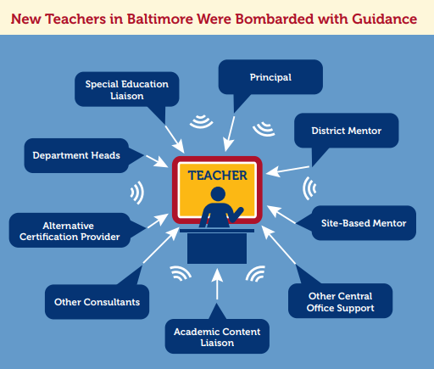
Example: Teacher Evaluation in Baltimore
Root cause analysis revealed some teachers received too little feedback, while others were bombarded with uncoordinated feedback.
Lessons Learned:
Examine root causes before developing solutions
Consider problem from end users’ perspectives
Be open to alternative theories
Bryk, A.S., Gomez, L.M., Grunow, A, and LeMahieu, P.G. (2015). Learning to improve. Cambridge: Harvard Education Press.
Notes:
A case in Baltimore City provides a great example of how an RCA works to uncover root causes that often remain hidden.
Like most states, Maryland had a system of evaluation in which almost all teachers were rated satisfactory, yet their student achievement and school quality results suggested otherwise. So Maryland enacted new policy mandating that districts evaluate teachers annually and provide detailed feedback for improvement.
Most districts formed teams, developed new evaluation protocols and procedures, and began a system-wide rollout of the new procedures. Baltimore took a step back and asked, “How can we improve the system we currently have?” They knew their evaluation system was not working well, but they didn’t know why. So they created a NIC and, collectively, the team followed up directly with teachers who experienced the evaluation process.
After much investigation and involvement from teachers, principals, district staff, and parents, they found that:
Many teachers indeed were not receiving detailed and quality feedback that can change practice.
But this was only part of the problem, which only affected some, but not all, teachers.
While more experienced teachers were getting little to no feedback on their teaching, new teachers were getting too much feedback and most of it was uncoordinated and often provided conflicting recommendations. For example, many new teachers were Teach for America (TFA) graduates. They were receiving feedback from their TFA coaches. Additionally, they were assigned mentor teachers who provided feedback. On top of that, the school principal and instructional coaches were providing feedback, as well as department heads and district staff who visited the schools periodically. Not only was this too much feedback, but the feedback was uncoordinated and often conflicting.
Knowing this changed how Baltimore approached the problem. Instead of adding more procedures, their solutions focused on how to coordinate and distribute feedback processes so that all teachers received consistent and ongoing messages about how to improve their instruction.
Lessons Learned:
Examine root causes carefully
Consider problems from the end users’ perspectives
Be open to alternative theories for why problems may be occurring

Slide 8
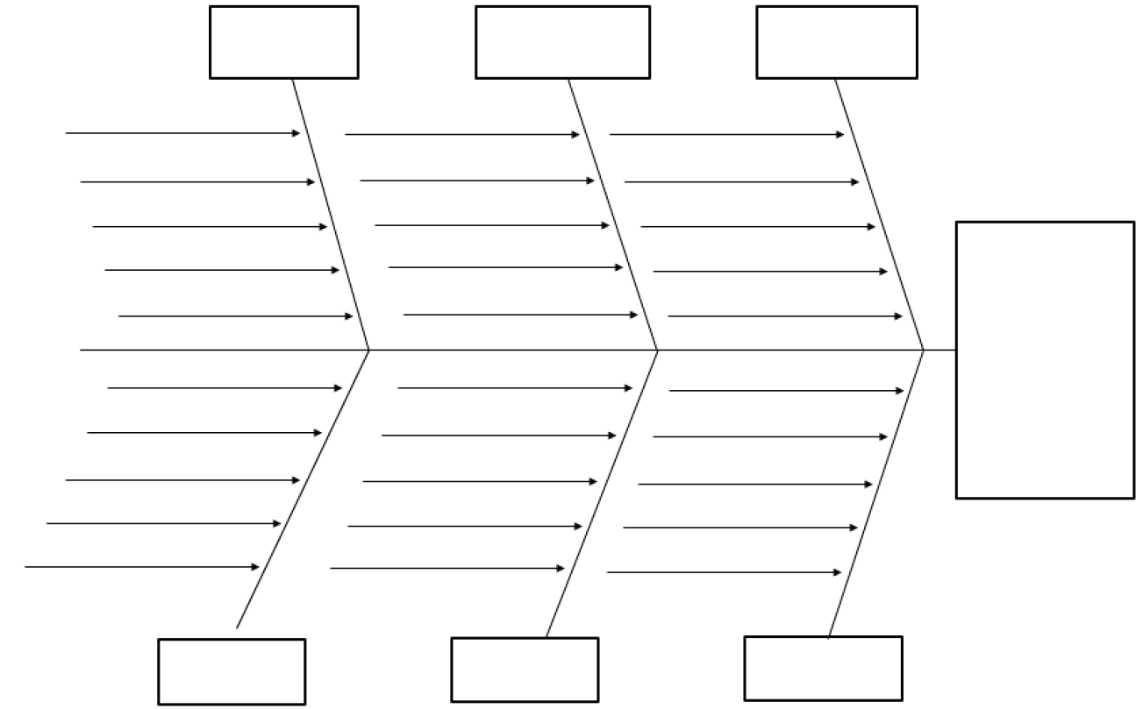
Identifying Root Causes Using a Fishbone Diagram
Initial Causes
Problem Statement
Subcauses
Root Cause
Notes:
A blank fishbone diagram is shown here. Fishbone diagrams can be a useful way of organizing and connecting initial causes to narrower related causes that lead to a root cause.
The diagram includes a head, which lists the problem or issue to be studied; a backbone for the fish, which is a straight line that leads to the head; the initial causes with arrows that are connected to the spine to create the first bones of the fish; and additional causes added to continue breaking down each cause until the root causes have been identified.
The purpose of the fishbone diagram is to challenge the team’s thinking about where and how productive changes should be introduced. These should influence identification of a small but powerful set of drivers to initiate improvement, which we will engage with in our next meeting.
How does the RCA work in practice? We are going to approach this with a three-step process.
Step 1: The first step is to identify initial causes of the problem. These are usually high-level problems that are the most obvious and easiest to identify. This will happen through a brainstorming activity in which everyone identifies potential problems that may be contributing to why teachers are struggling to use digital tools to support instruction and formative assessment.
Step 2: We’ll collectively organize the problems into a smaller set of categories and ask the NIC members to consider the problems and identify the top three to focus on today.
Step 3: Once we have our three “initial causes” identified, we’ll split into small groups and each small group will consider subcauses that influence the larger initial cause. This happens by asking, “Why are we getting the results we observe?” over and over again. It usually takes four or five (but can take more if needed) “whys” before you get to the root cause.

Slide 9
Progressing from Problem Statement to Root Causes
Example
Problem Statement: Teachers’ effective use of digital tools to support classroom formative assessment is limited and varies widely.

Slide 10
What Are the Possible Reasons Why Formative Assessment Use Is Declining in Remote Environments?
Technology access for students varies widely
District/school-based technical support for digital learning is insufficient
Teachers are unaware of the digital tools available to them
Teachers need training to integrate digital tools into instruction

Slide 11
Why Does Technology Access Vary So Widely? Because...
Districts have insufficient resources to purchase technology (e.g., WiFi, computers) for all students.
Why?
Why?
Face-to-face (F2F) instruction enabled districts to overlook technology access as a need.
Universal access was not a perceived necessity until spring 2020.
Why?
Teachers are more comfortable using traditional practices; technology literacy varies.
Why?
Teachers perceive technology as unreliable and more trouble than it is worth.
Notes:
Here is an example of what you’ll do in your small groups.
As I mentioned, step one will consist of identifying initial causes of a problem.
Once we have those, we’ll assign one to each group.
You’ll recall that our original problem is that teachers’ use of digital tools to support effective formative assessment is limited and varies widely.
Let’s say that one of the initial causes contributing to the problem is that technology access is not universally available to all students. As a result, teachers can’t use technology effectively because some students can access it and some can’t. From here we ask, “Why?” Why is technology access not universally available?
Someone might say, “because districts have insufficient resources to purchase technology for all students.” Why is that?
Universal access to tech was not a perceived need until COVID-19 came along. Why is that?
F2F instruction enabled districts to overlook tech access as a tool that could enhance instruction as opposed to supplement instruction. Why is that?
Teachers tend to be more comfortable sticking with F2F strategies and tend to avoid the use of digital tools. Why is that?
Teachers perceive technology as unreliable and more trouble than it’s worth.

Slide 12
Underlying Root Causes Related to Technology Access
Possible solutions shift from insufficient resources or “more money” to:
Shifting resources to ensure all students have reliable computer and WiFi access;
Building a more robust district technology infrastructure;
Increasing awareness of digital tools available to teachers;
Providing school-wide training to integrate technology into instruction; and
Building a technology support system in schools.
Notes:
Notice that the root cause here may be that teachers perceive technology as unreliable. (Although some may be able to use it, they have avoided it because it doesn’t always work as it should. As a result, they stick to F2F strategies).
This is a much more concrete and narrow cause than was our original statement that technology is not universally available. And the way you approach the problem of unreliability may be much different than how you approach lack of universal access. Ultimately, you may need to address the problem of universal access, but how you approach this will likely be different now that you have a deeper understanding about how this problem emerged in the first place.

Slide 13
Lack of universal technology access
Weak district infrastructure
Insufficient training and digital literacy
Districts did not budget for technology
Universal tech not a necessity until 2020
F2F prevented tech as perceived need
Effective use of digital tools to support classroom formative assessment is limited and varies widely
Teachers prefer not using tech; low literacy
Teachers perceive tech as unreliable
Schools unaware of digital tools available
Insufficient technology support in schools
Branch 6
Notes:
Once we have our root cause and subcauses, we can fill them in under the initial cause we identified which was “lack of universal access to technology.”

Slide 14
Activity 1: Identify Subproblems
In one to three words, why are we getting the results observed?
To join, enter “PollEv.com/chrisbrandt590” in your browser.
Click Here to Begin
Notes:
Before we move to our next activity and begin the RCA, does anyone have any questions or comments at this point?
I’m going to copy and paste a link into the chat. Please copy that link, paste into your web browser, and that will take you to a page that allows you to enter your thoughts into a survey poll. We encourage everyone to participate, even those of you from other states. Although state contexts differ, it is likely that many of the problems or causes that prevent digital solutions from working as planned may be similar.
Using the problem statement identified on slide 9, the question we would like you answer is this: “Why are we currently getting the results that we get?” We encourage everyone to respond as many times as you’d like. As you respond, you will notice a word cloud forming. The bigger words and phrases mean that more people responded with that exact same word/phrase. If you see a word or phrase that resonates with you, you can write it into the poll, and the words will grow to show which ones seem to resonate with most people.
We are going to focus on the top three initial causes that emerged from this exercise, in order to identify what is at the root of these higher level causes.

Slide 15
Activity 2: Small Groups
Identify the key themes from Activity 1
Each group will take one cause and ask, “Why do we get these results?” Continue asking “why?”
Typically, it takes five to seven “why” questions before you get to a root cause.
Notes:
Now I’m going to split you into groups.
Assign problems to groups.
Assign a recorder for each group. Recorders will record sub-causes and the root cause that emerges during the group discussion.
You have 20 minutes to discuss and then we’ll come back as a group.
Before you come back, please be sure to select someone who is willing to share the underlying sub-causes and the root cause that your group identified.

Slide 16
Next Steps
Create an initial fishbone diagram using root causes that emerged in this meeting.
Continue identifying and unpacking new subproblems as they emerge.
Iterate the fishbone diagram with a diverse group of end users (i.e., teachers). This may require multiple sessions over the series of several weeks or months.
Once the fishbone diagram is complete, use it to inform the theory of improvement.

Slide 17
This presentation is in the public domain. While permission to reprint is not necessary, publication should be cited. The presentation is prepared by the Region 5 Comprehensive Center under Award #S283B190030 for the Office of Program and Grantee Support Services (PGSS) within the Office of Elementary and Secondary Education (OESE) of the U.S. Department of Education and is administered by Westat. The content of the presentation does not necessarily reflect the views or policies of the PGSS or OESE or the U.S. Department of Education nor does mention of trade names, commercial products, or organizations imply endorsement by the U.S. Government. © 2021 Westat.

