Slide 1
Region 5 Networked Improvement Community
Overview
[Month, Year]

Slide 2
Framing the Problem
COVID-19
Wide Variability in Schools’ Capacities to Support Learning*
School and Student Inequities
Technology Access (e.g., laptops, tablets)
Teacher Training to Deliver Online Instruction
Social and Emotional Learning
Learning Management Systems
Academic Learning
Online and Blended Course Offerings
Teacher-Student Relationships
Plans to Deliver Instruction During Prolonged Closures
*Diliberti, M., Schwartz, H.L., Hamilton, L.S., and Kaufman, J.H. (2020). Prepared for a pandemic? How schools’ preparedness related to their remote instruction during COVID-19. Santa Monica, CA: RAND Corporation. Available at: https://www.rand.org/pubs/research_reports/RRA168-3.html.
Notes:
In spring 2020, in-person schooling shut down due to the rapid spread of the coronavirus.
Most state and local education agencies were not organized to support basic online learning practices, which included
Methods for ensuring equitable technology access
training for teachers to effectively deliver online instruction
Access to online courses, and
plans to deliver online instruction during prolonged closures (Diliberti et. al, 2020).
Diliberti, M., Schwartz, H.L., Hamilton, L.S., and Kaufman, J.H. (2020). Prepared for a pandemic? How schools’ preparedness related to their remote instruction during COVID-19. Santa Monica, CA: RAND Corporation. Available at: https://www.rand.org/pubs/research_reports/RRA168-3.html.

Slide 3
Project Purpose
KY: How digital tools can be used to improve classroom formative assessment
Implement improvement science in a networked improvement community.
Identify, test, and scale technology-based strategies to promote meaningful student learning experience during and post-COVID.
Regional Question
How can data and technology be used to improve students’ learning experiences?
WV: How schools can seamlessly shift across remote, blended, and face-to-face instructional models
TN: How state leaders can promote data-driven decisionmaking in schools
VA: How digital tools can be used to engage students in meaningful learning experiences
Notes:
In June of 2020, the Region 5 Comprehensive Center partnered with four state education agencies to address these problems. During the initial kickoff meeting, state leaders shared how they were responding to the crisis. They also discussed plans for ensuring technology access and improving online instruction. Through these conversations, the group identified a common question that united them: how can data and technology be used to improve students’ learning experiences? Additionally, how can states systematically share what they learn to accelerate instructional improvement across the four-state region?
To address these questions, the group formed a Networked Improvement Community (NIC). The NIC would become the vehicle through which states could identify, test, and scale effective online and blended learning practices, which would be designed to improve instruction both during and after the COVID crisis.
Diliberti, M., Schwartz, H.L., Hamilton, L.S., and Kaufman, J.H. (2020). Prepared for a pandemic? How schools’ preparedness related to their remote instruction during COVID-19. Santa Monica, CA: RAND Corporation. Available at: https://www.rand.org/pubs/research_reports/RRA168-3.html.

Slide 4
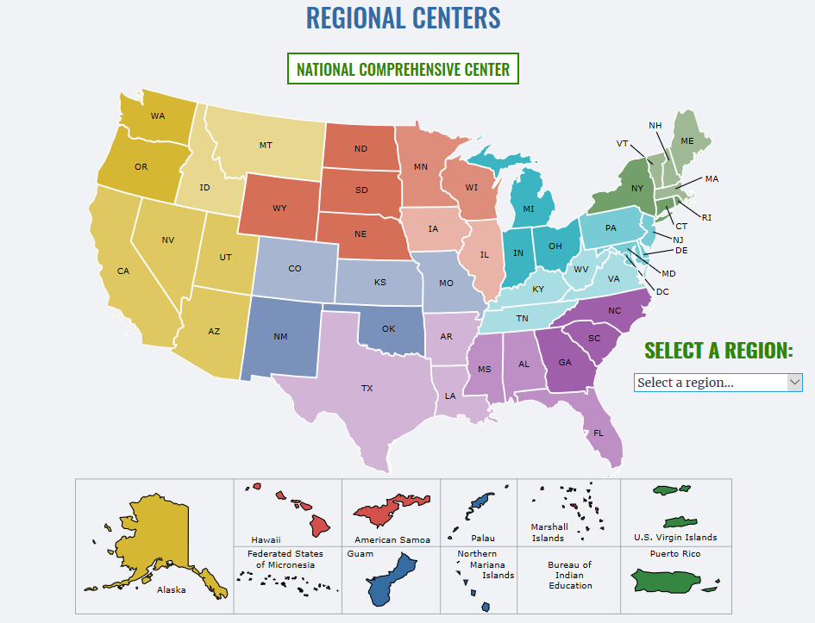
Project Participation
The Region 5 Comprehensive Center is a 5-year cooperative agreement with U.S. Department of Education (ED).
Operated by Westat, the Comp Center provides capacity-building services to state education agencies in Kentucky, Tennessee, Virginia, and West Virginia.
Region 5
Notes:
The Region 5 Comprehensive Center is currently leading the Networked Improvement Community Project.
The Region 5 Comprehensive Center is one of 19 regional centers across the country. It is funded through a cooperative agreement with the U.S. Department of Education. And its goal is to provide capacity-building services to state education agencies. Westat is the primary Region 5 contractor, and AEM and the Center for Assessment are key partners.

Slide 5
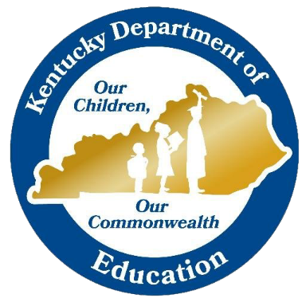
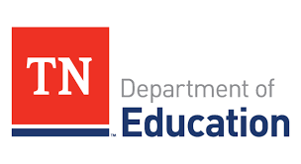
Key Participants
Notes:
Key partners with the Region 5 Comprehensive Center include the Center for Assessment and state education leaders from Kentucky, Tennessee, Virginia, and West Virginia.

Slide 6
What is a Networked Improvement Community (NIC)?
A NIC works together to address common problems of practice using improvement science. A NIC has four distinctive features:
A well-specified problem,
Deep understanding of the problem within a given context,
Iterative cycles of improvement (i.e., plan-do-study-act), and
Coordinated spread of effective practice across different contexts.
Notes:
A Networked Improvement Community, or NIC for short, brings together experts with diverse backgrounds to solve well-defined problems. They use methods of improvement science to identify, test, and scale-up solutions.
Every NIC has four distinctive features:
A well-specified problem;
Deep investigation to understand a problem and its root causes within a given context;
Iterative cycles of inquiry that include planning a solution, testing its effectiveness in a classroom or school, studying the results, and using results to further refine the intervention before it is tested again or implemented in a new site; and
Coordinating the spread of practices across classrooms and schools.
For more information, see https://www.carnegiefoundation.org/blog/why-a-nic/.

Slide 7
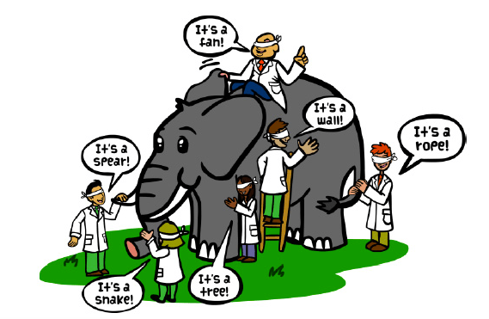
How Will the Region 5 NIC Improve Instruction?
States face a difficult problem during COVID: how to ensure all students have access to high-quality instruction.
The NIC allows states to share what they learn as they address a problem from different angles. This process accelerates learning for everyone.
Notes:
How will the Region 5 NIC address COVID-related problems?
States face a difficult problem during COVID: how to ensure all students have access to high-quality instruction.
The NIC allows states to share what they learn as they address a problem from different angles. This process accelerates learning for everyone.
For example, Kentucky is learning how digital tools can be used to improve online instruction. West Virginia is collecting data to understand how schools effectively shift instruction across online, blended, and face-to-face environments. As these states identify and share solutions to these problems, they build collective capacity to address broader common problems that exist among them.

Slide 8
Participant Responsibilities
What are the key responsibilities of state partners?
Participate in regular meetings (biweekly)
Oversee and/or support the work
Provide ongoing data/information
What are the expected time commitments of state partners?
2 hours/month for meetings and ongoing support
Beyond that, levels of participation will likely vary
Notes:
Region 5 NIC participants are generally responsible for:
Participating in meetings once or twice each month,
Supporting development of the NIC learning modules, and
Contributing data and information to support the regional NIC.
Expected time commitments will vary from person to person. Most participants are expected to contribute about 2 hours/month, which includes participation in monthly NIC meetings. Core members of the NIC Initiation Team, such as the state champion or continuous improvement leader, the research or data director, and content experts, will need to commit additional time. These members of the state-based NIC initiation teams are responsible for recruiting district and school staff to test various solutions, gathering and analyzing data to monitor improvements, and communicating progress to other stakeholders within and outside the SEA.

Slide 9
NIC Model of Change
Increased Capacity to Address Problems of Practice
Root Causes
Theory of Action
Improved Practice
Problem of Practice
Logic Model
Measurement Infrastructure
Improvement Science (Plan, Do, Study, Act)
Notes:
This slide presents a model of change to illustrate how a NIC works to improve outcomes.
The group starts by identifying a well-defined problem of practice.
The group then identifies root causes and uses them to inform a theory of improvement.
The theory of improvement specifies the resources, activities, and outputs that produce a given set of outcomes.
Next, the group creates the measurement infrastructure by identifying specific measures to monitor and evaluate whether the plan is working as intended.
Once the measures are complete, the NIC implements the plan-do-study-act cycle of improvement science to study and improve the proposed theory of improvement.
As the NIC learns about what works, for whom, and under what conditions, solutions can be implemented in more and more sites.
And finally, through iterative practice, individual and collective capacities of the NIC increase as they improve their ability to effectively address problems.

Slide 10
Project Resources
Project Overview
Project Timeline
Learning Modules (under construction)
Region 5 NIC Members
Notes:
NIC resources and learning modules will be made available as soon as they are completed and approved by the U.S. ED. Links on this slide will be added as resources are approved for dissemination.

Slide 11
For More Information
Contact
Lori Vandeborne, Technical Assistance Specialist; Lori.Vandeborne@aemcorp.com; (740) 251-3957
Chris Brandt, Associate, Center for Assessment; cbrandt@nciea.org; (630) 864-7592
Kimberly Hambrick, Region 5 Comprehensive Center Director; Kimberly.Hambrick@westat.com; (304) 206-6819
Notes:
For more information about the Region 5 NIC project, contact Lori Vandeborne, Chris Brandt, or Kimberly Hambrick. And once again, welcome to the Region 5 Networked Improvement Community.

Slide 12
This presentation is in the public domain. While permission to reprint is not necessary, publication should be cited. The presentation is prepared by the Region 5 Comprehensive Center under Award #S283B190030 for the Office of Program and Grantee Support Services (PGSS) within the Office of Elementary and Secondary Education (OESE) of the U.S. Department of Education and is administered by Westat. The content of the presentation does not necessarily reflect the views or policies of the PGSS or OESE or the U.S. Department of Education, nor does mention of trade names, commercial products, or organizations imply endorsement by the U.S. Government. © 2021 Westat.

